Slide 1

AVIATION AIRLINE

Slide 2
PROJECT COLLABORATORS
Mr. Aditya Raval Ms. Richa Mishra
Ms. Arpita Hiremath
Mr. Shashikanth Muthe
Mr. Areef Akula
Ms. Iravati Narendra More
Mentor
Mr. Kunal Kumar Nath

Slide 3

01
KPI Analysis
02
Insights
03
Excel Dashboard
Content
04
Power BI Dashboard
05
Tableau Dashboard
06
Setbacks
07
Resolutions

Slide 4

KPI Analysis
01
WEEDAY VS WEEKEND TOTAL FLIGHTS
Out of 281K flights in total, Weekdays hold up the majority with 205K, while weekend flights sum up to be 74K

Slide 5
KPI Analysis
02
NUMBER OF CANCELLED FLIGHTS FOR HONOLULU,HI(ORIGINCITYNAME)
8
Cancel flight From Honolulu
There is a Total of 6,038 cancelled flights. Out of the total cancellations, only 8 flights are from Honolulu, HI.

Slide 6
KPI Analysis
03
WEEK WISE STATISTICS OF ARRIVAL OF FLIGHTS FROM MANCHESTER AND DEPARTURE OF
FLIGHTS TO MANCHESTER
The Total number of arrivals (287) is less than the total number of departures (302), indicating a net outflow of flights from Manchester during this period.

Slide 7
KPI Analysis
04
TOTAL DISTANCE COVERED BY N190AA ON 20TH JANUARY
The Total distance of 6823 represents the cumulative distance covered by the specific aircraft N190AA on January 20th.
.

Slide 8

Insights
01
02
03
04
Flight Trends
Cancellations
Weekly Statistics
Air Distance
Business travel vs Leisure travel
Pricing and Demand Management
Scheduling Optimization
Potential Regional Issues
Customer Impact
Emergency Preparedness
Aircraft Turnaround
Connecting Flights
Economic Impact
Efficiency and Utilization
Maintenance Considerations
Route Analysis

Slide 9

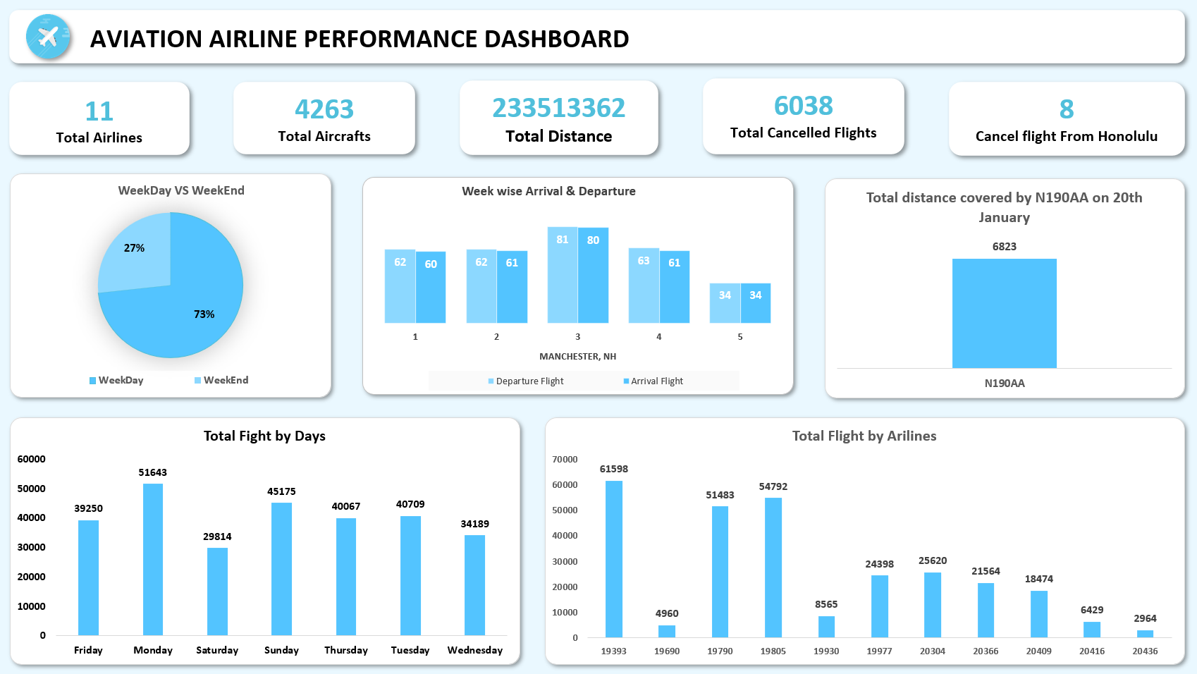
Excel Dashboard

Slide 10

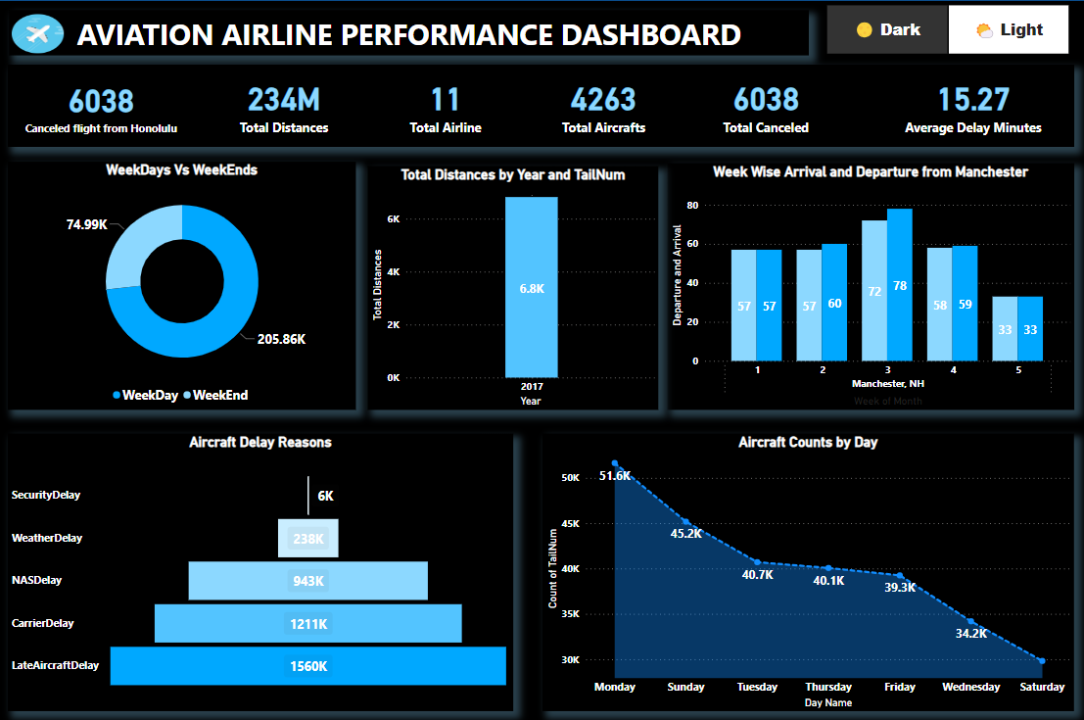
Power BI Dashboard

Slide 11

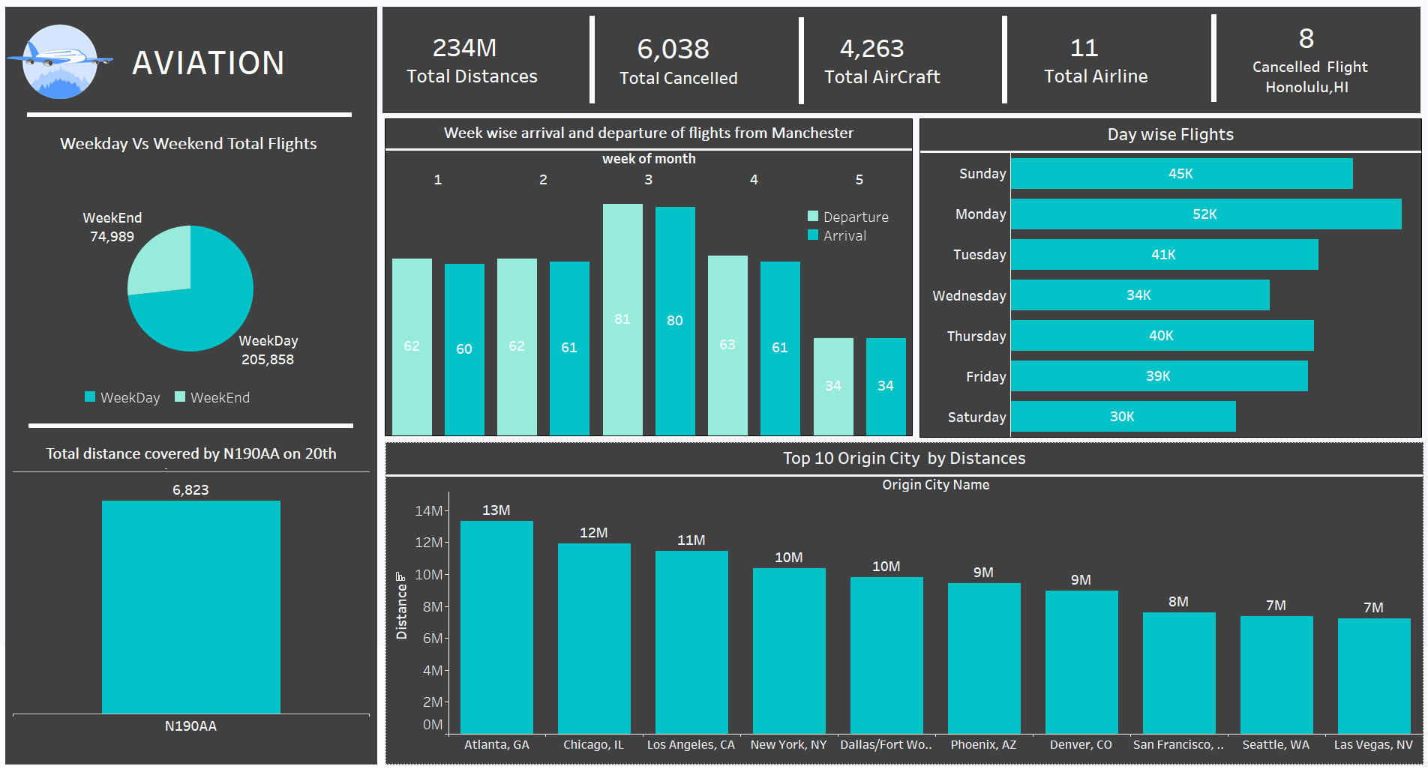
Tableau Dashboard

Slide 12
Setbacks and Solutions
Data Connection :
Creating relationships determining relationship type.
Creating Primary Key
Data Cleaning :
Detecting missing values.
Dealing with Duplicate values
Creating Custom-coded SQL Queries
Standardisation :
Legitimation of data Types
Correction of Formatting
Enrichment :
Calculating the KPIs
Creating Calculated metric
Data Visualisation :
Plotting the accurate type of chart
Calling attention to important factors
Usage of Colour Theme.

Slide 13

Resolutions
Power Pivot and Data Modelling
Data Profiling and Curation
Customised Standard Processes
Calculated Fields attending to the problem
Finding the accurate BI tool to cater the esstial type of dashboard

Slide 14
THANK YOU!

